Slide 1


welcome!
Mick Girdwood & Prasanna Sritharan
25 May 2022

Slide 2

Dr Prasanna Sritharan
Postdoctoral Research Fellow
La Trobe Sports & Exercise Medicine Research Centre
p.sritharan@latrobe.edu.au @psbiomech
Research interests:
Musculoskeletal modelling, biomechanical simulation
I use R for:
Data analysis, wrangling, visualisation

Slide 3

Mick Girdwood
PhD Student / Physiotherapist
La Trobe Sports & Exercise Medicine Research Centre
m.girdwood@Latrobe.edu
Research interests:
Muscle strength and cortical processes in MSK injuries
I use R for:
Data management, wrangling, analysis and visualisation

Slide 4
Today’s agenda???
List

Slide 5

Objectives
Friendly and regular meet up to help share the joy of R and other coding methods, between researchers and students

Slide 6
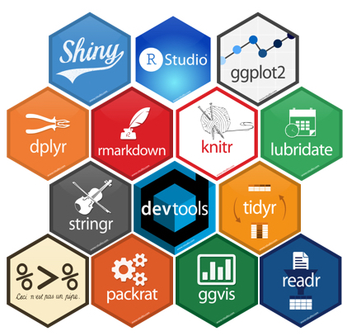
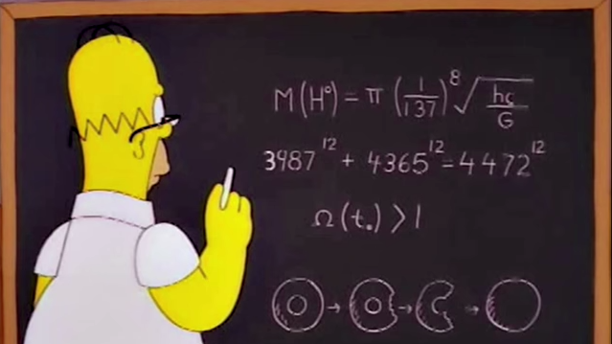


Share our experiences with new packages
Workshops to help develop coding skills
Regular drop-in sessions for coding help
Initiate new collaborations
and explore new ideas and methods

Slide 7

Scenario:
Gait Experiments

Slide 8
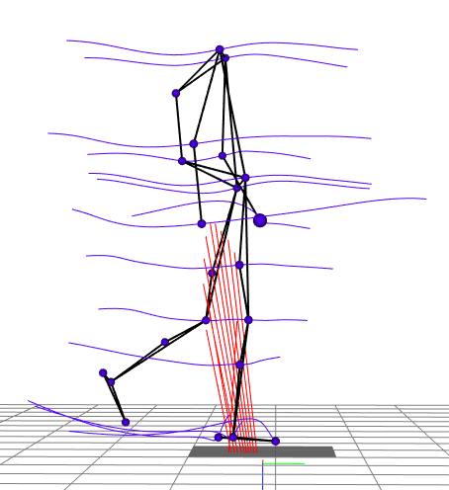


Experimental data
SUBJECT 1
SUBJECT 2
50 participants
25 symptomatic, 25 control
10 trials per participant
500 trials total
(250 trials per group)
20 measured temporal
variables per trial + time
Each trial duration is different
10 CSV files per participant
21 data columns per file
+ 1 Excel spreadsheet
with participant info
(group, age, mass, sex, etc)

Slide 9

Your mission
*
Calculate descriptives for each variable
(mean, variance, etc)
Perform inferential testing on each variable
(t-tests, F-test, ANOVA, SPM{?}, etc)
Generate plots of the mean of
each temporal variable with
±1 std dev shaded
Indicate regions of significance

Slide 10
Workflow
Collate & merge data
Raw data
Clean
Preparing for analysis
(“Data wrangling”)
Reshape
(not necessarily in this order)
Resample
Mutate
Prepped data
Recode

Slide 11
Gather all the raw data into one place
Collate & merge data
Raw data
Clean
500 CSV files & 1 spreadsheet
Reshape
1 table
Resample
Mutate
Prepped data
Recode

Slide 12


Throw out or rectify bad data
Collate & merge data
Raw data
Clean
Reshape
Deal with missing data
Resample
Mutate
Prepped data
Recode
data?

Slide 13
Collate & merge data
Raw data
Clean
Wide form
Categorical data is grouped
Easy to read and interpret
Reshape
Resample
Mutate
Prepped data
Long form
One observation per row
Easy to store, select and manipulate
Recode

Slide 14
Collate & merge data
Raw data
Clean
Reshape
Subject A
Subject B
Resample
Mutate
Prepped data
Recode

Slide 15


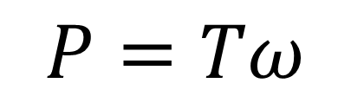
Create new variables from existing ones
Collate & merge data
Raw data
Clean
Newtons
Body weights
Reshape
Normalisation
Resample
$$P=Tω$$
Mutate
Prepped data
Joint angular power from joint moments and joint velocities
Recode

Slide 16
Collate & merge data
A
Raw data
Clean
B
Reshape
Resample
A1
A2
A3
A4
Mutate
Prepped data
B1
B2 B3 B4
Recode

Slide 17
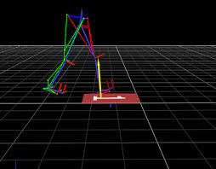
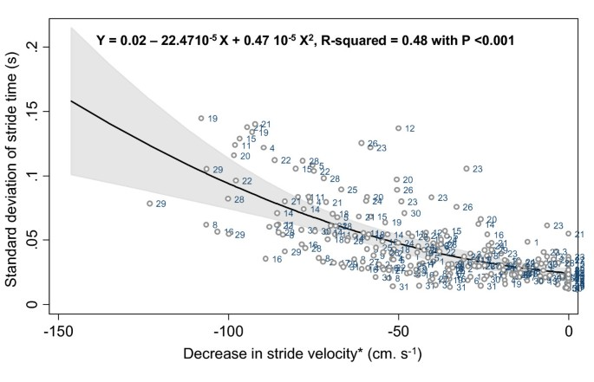
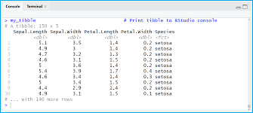
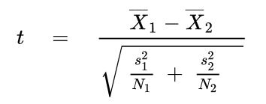
How can scripting help?
Acquire data
Prepare data
Modelling &
Analysis
Report/
Visualise

Slide 18

How can scripting help?
Lifelong skill, improves problem solving through structural thinking
Flexibility, the language isn’t important, it’s the thinking – languages are the easy part
Enables abstraction, reusability, efficiency, and minimises errors
Competitive advantage, scripting is not domain-specific, take it with you to your next job
Develop an in-depth understanding of what your are doing and why

Slide 19
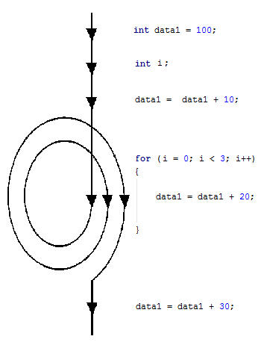

How can scripting help?
Algorithms, data structures, control flow, functions
e.g. Loops:
Repeat actions until job done
e.g. load each CSV and append data to a table.
Tools and functionality
Useful tools to help you do what you need to do, e.g. tidyverse for data wrangling and visualisation.
Reusability & flexibility
Scripts and functions you develop can be modified and reused for other projects, saving time and effort.

Slide 20


Promotes more systematic management of information
my_project
scripts
data
outputs
script1.r
subject1
analyses
script2.r
subject2
figures

Slide 21

WHY USE R?
R is a programming language
Rich, flexible and powerful
Specifically developed for statistical programming and data analysis
Comes pre-built with many useful tools for statistics and analysis, data wrangling and visualisation
Easy to set up, easy to learn

Slide 22
Collate & merge data
Raw data
Clean
Preparing for analysis
(“Data wrangling”)
Reshape
Resample
Mutate
Prepped data
Recode

Slide 23
Implement your whole workflow with R scripts!
Acquire data
Prepare data
Modelling &
Analysis
Report/
Visualise

Slide 24
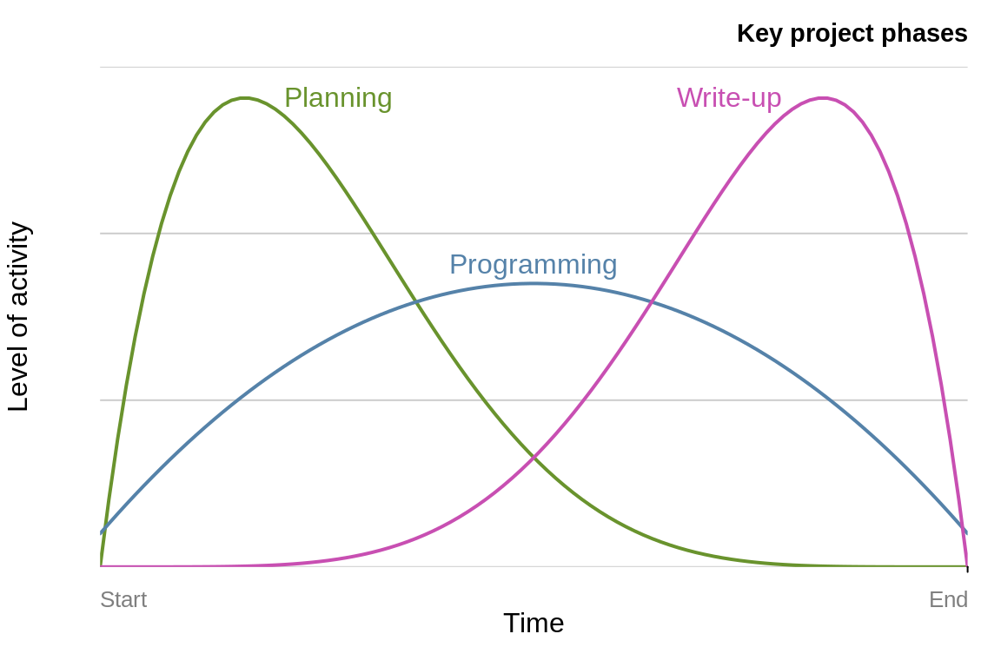
Programming ≠ statistics

Slide 25
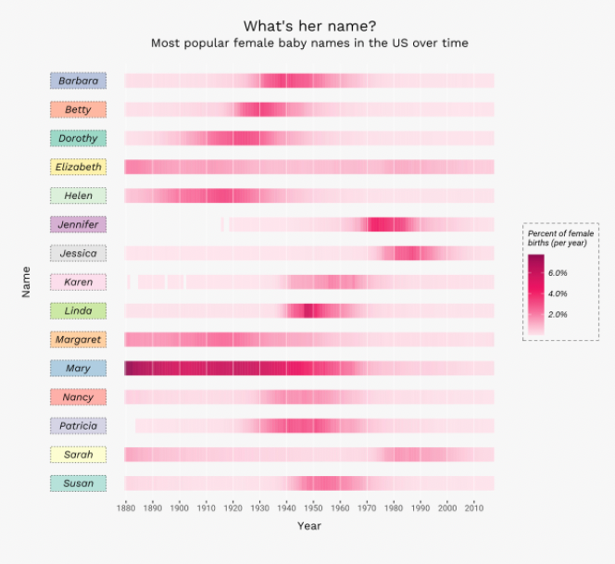
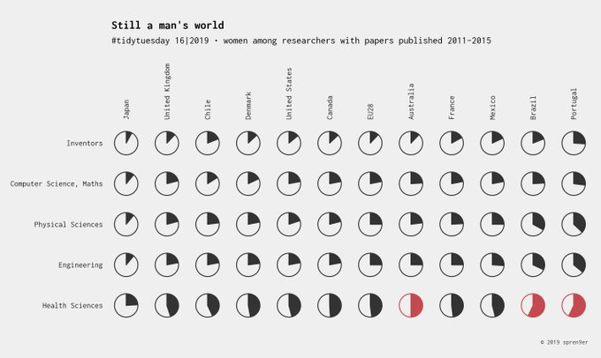
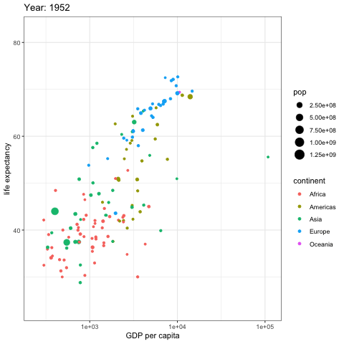
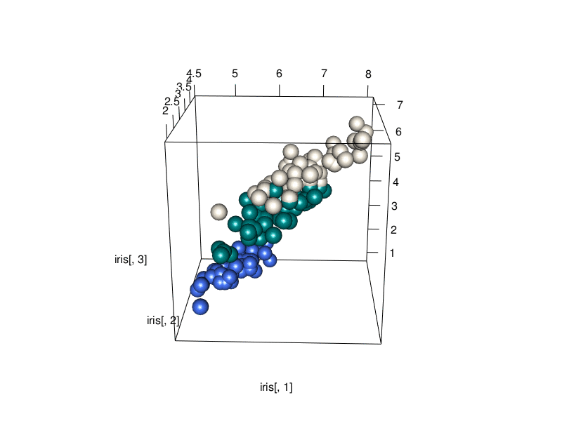
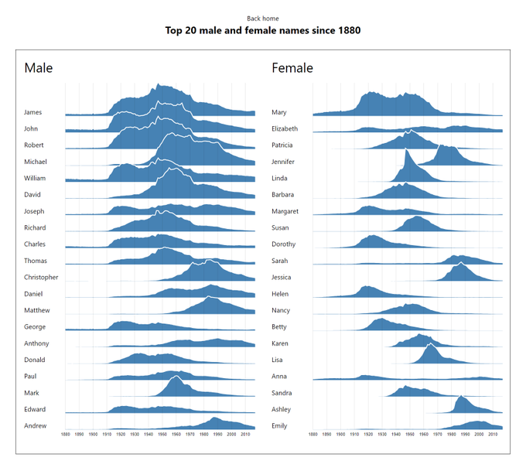
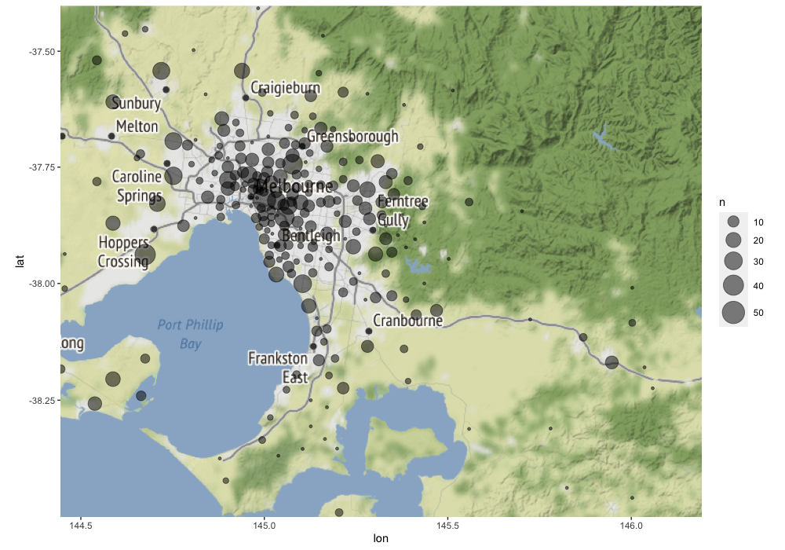
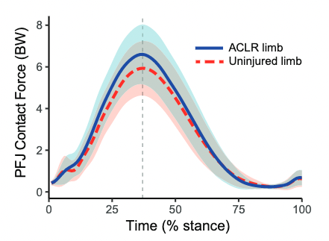
LESS OBVIOUS APPLICATIONS
Rich, sophisticated visualisations

Slide 26
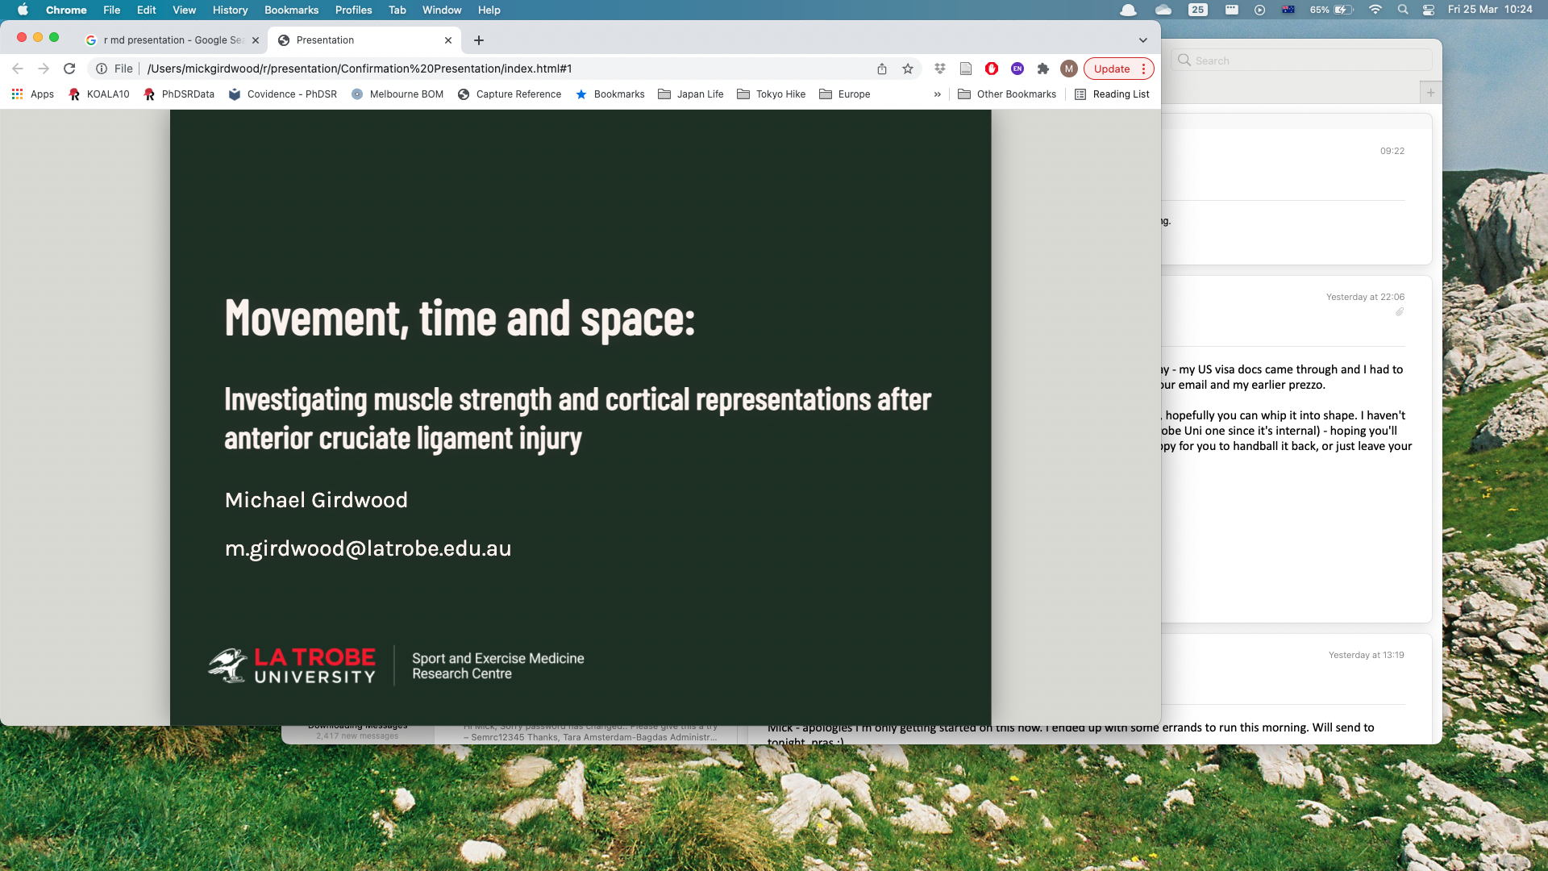

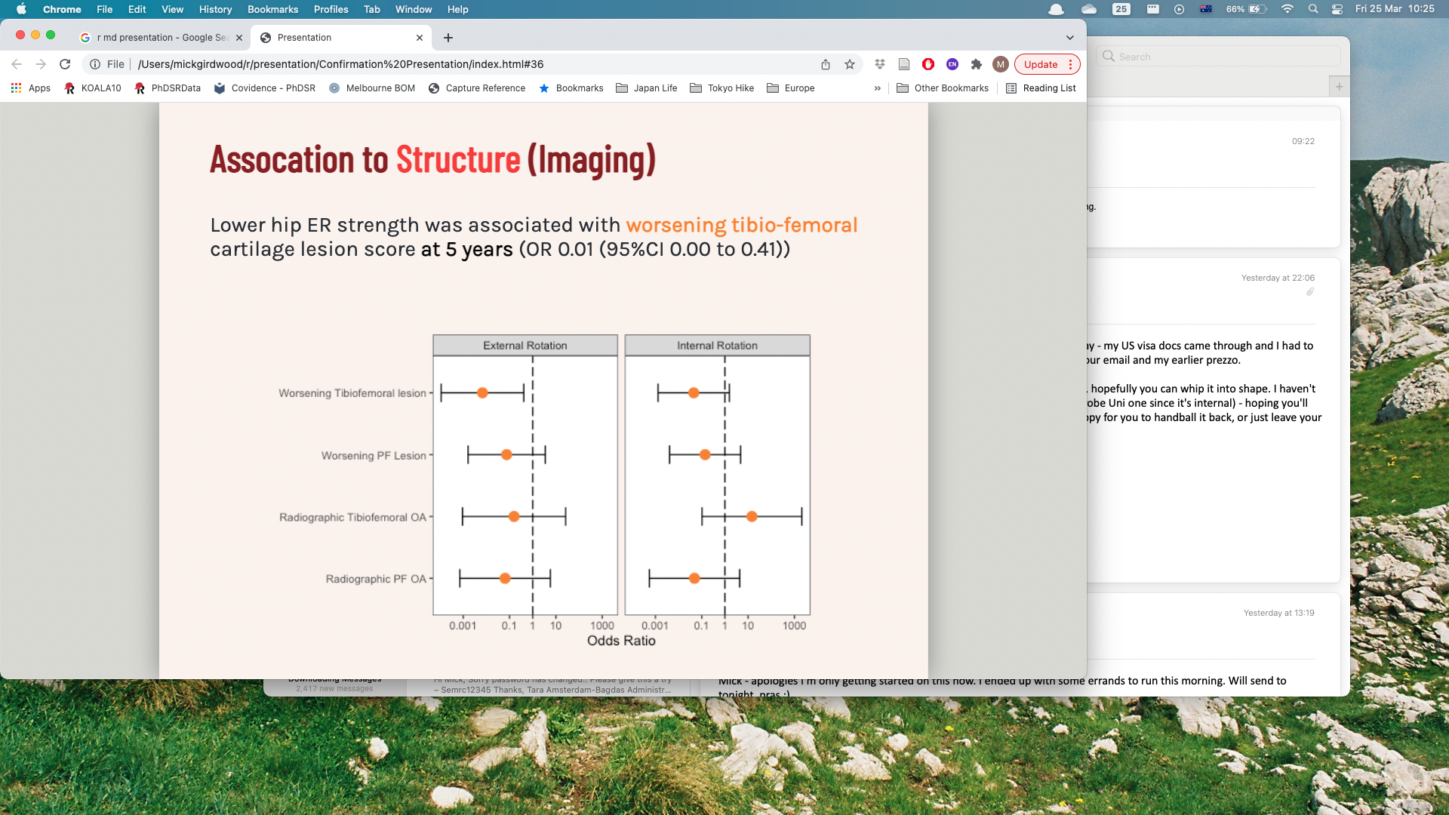
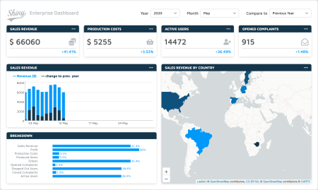
Less obvious applications
Presentations/Slides
Websites / Dashboards / Apps

Slide 27
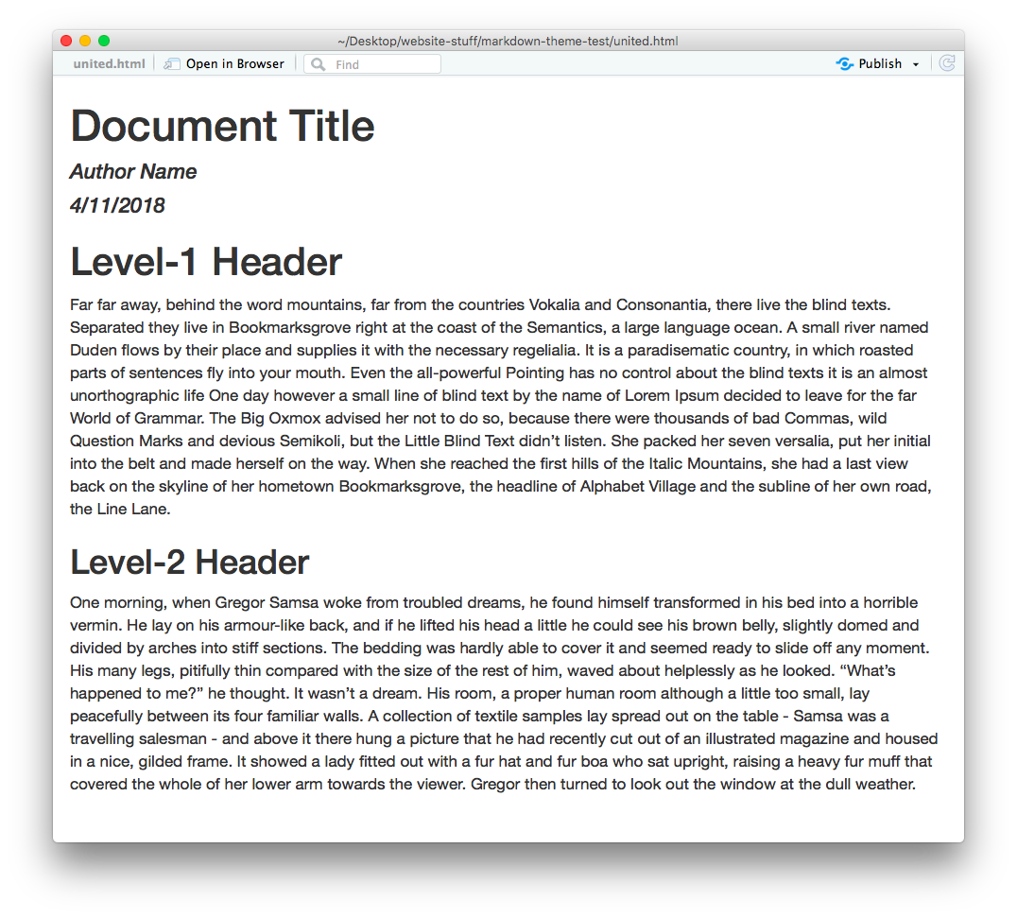

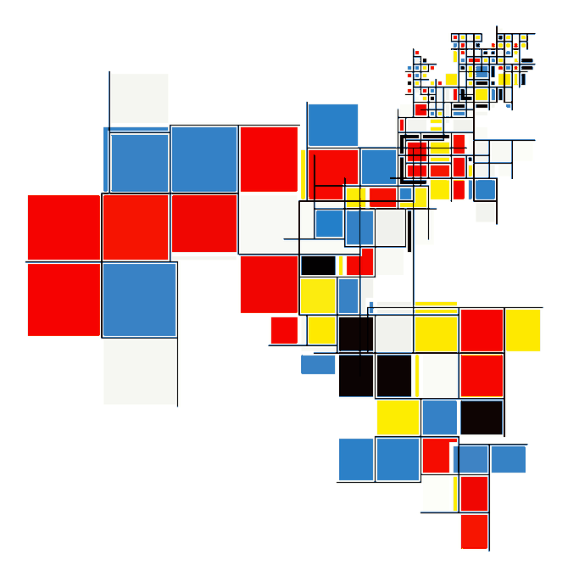


Less obvious applications
Documents / Reports
Art!

Slide 28
WORKED EXAMPLE

Slide 29
OVER TO YOU!

Slide 30

Resources
https://swirlstats.com/

Slide 31

Resources
https://r4ds.had.co.nz/index.html

Slide 32

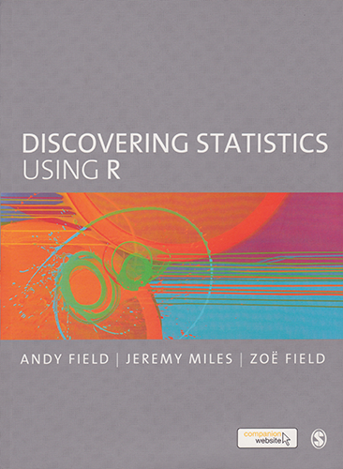
Resources
https://www.discoveringstatistics.com/books/discovering-stat
https://bookdown.org/ndphillips/YaRrr/

Slide 33

RESOURCES

Slide 34
BRING a problem to Solve!

Slide 35
THANK YOU!
Presentations, code and other stuff available here
(for the moment, until we can find a nice place for them):
https://github.com/latr-meetups/latr

Slide 36

PLEASE SEND uS YouR DETAILS!
https://forms.gle/BdKLJgHU8nyg4LZcA

